Slide 1

College Admission Management
System
Project Report
SUBMITTED TO SAVITRIBAI PHULE PUNE UNIVERSITY
SUBMITED BY
Students Name: Sakshi Sunil Korde ROLL NO: 056
Students Name: Roshan Pramod Muneshwar ROLL NO: 102
UNDER THE GUIDANCE OF
Kalyani Alisethy Mam
In Partial Fulfillment of MASTERS IN COMPUTER APPLICATION
SINHGAD INSTITUTE OF BUSINESS ADMINISTRATION AND RESEARCH
KONDHWA, PUNE-411048 2022-2023

Slide 2
CERTIFICATE OF ORIGINALITY
is is to certify that the project report entitled
……………………………………………….…...
…………………………………………………………………………………………………...…. Submitted to the Department of Computer Applications, Sinhgad Institute of Business Administration and Research in partial fulfillment of the requirement for the award of the degree of MASTER OF COMPUTER APPLICATIONS (MCA Affiliated to Savitribai Phule Pune University), is an original has not been submitted whether to this Organization or to any other University/ Organization for the fulfillment of the requirement of any course of study.
rk carried out by
Mr/Ms…………………………………Exam No…………….…..
under my guidance.
The matter embodied in this project is a genuine work done by the student and
Signature of the Student :
Name of the student : Signature of the Guide : Name and Designation of the Guide :
Signature of Director-MCA
Dr. Netra Patil :
Date:

Slide 3
CERTIFICATE OF APPROVAL
This is to certify that the project report
entitled…………………………………………………….
…………………………………………………………………………
submitted to the Department of Computer Application, Sinhgad Institute of Business Administration and Research in partial fulfillment of the requirement for the award of the Degree of MASTER OF COMPUTER APPLICATIONS (MCA Affiliated to Savitribai Phule Pune University) is an original work carried out by Mr./Ms………………………………………Exam No……………
The matter embodied in this project is a genuine work done by the student and has been certified by the following internal and external examiners deputed by Savitribai Phule Pune University.
Internal Examiner Examiner
External

Slide 4
ACKNOWLEDGEMENT
We are pleased to acknowledge Kalyani Alisethy Mam for their invaluable guidance during the course of this project work. As our project COLLEGE ADMISSION MANAGEMENT SYSTEM which envelops the automation of all work. We have tried our level best to make our project as simple possible.
We would also like to give special thanks to all the talented personalities of our
institute who had given us a moral support completing our visual basic project.

Slide 5
CONTENTS
Introduction
Problem specification Background and related work Goals
Hardware Requirements Proposed System Overview
Flow chart ER Diagram
Data Flow Diagram Database and MySQL Tables Output screen
System Testing
Design and implementation constraints Supplementary requirements
Other nonfunctional requirement
Conclusion Reference

Slide 6
INTRODUCTION
Today all the work at the time of admission of the students is done manually by ink and paper, which is very slow and consuming much efforts and time. In the modern world of technology, computer are affecting our lives in more ways than we probably are aware of COMPUTERIZED MANAGEMENT maintaining information of an educational institute, colleges, other the list is endless. The main principle behind the need of college admission system is easy supervision of institutes. It can handle the details of students such as personal details or admission details. This Student Database has been designed taking into account the practical needs to manage a Students data. Moreover, it provides security at product level as well as user level. Its design concentrates on 2 types of users:
Admin
Students

Slide 7
PROBLEM SPECIFICATION
Student admissions are a vital part of any College’s running because students are what keep a College alive. The student admission is one of the most important activities within a College as one cannot survive without students. A poor admissions system can mean fewer students being admitted into a College because of mistakes or an overly slow response time. The process begins with a potential student completing an application form through the Universities and Colleges Admissions Service, the first step for students is to apply directly to the College through a custom online form. The next step is for the Admissions service center has to review the application and ensure that all of the required information has been provided. The application in its entirety is then forwarded, complete with a recommendation, to the respective department’s Admissions Tutor, who has the final say as to whether each potential student is Accepted or rejected. Before making a decision, the Admissions Tutor reviews the application and the additional documentation, comparing the academic credentials to a list of College rankings and previous, similar applications.

Slide 8
BACKGROUND AND RELATED WORK
The main aim of our project is to develop the application which will be useful in college admission system. As this college admission system project includes the admission process of student, starting from when the student takes admission in college in first year till that submission of examination form from the college. The requirement of the student is to:
User can contact with administrative by sending mails. User can view about us and contact us page.
User can view notices which is published by admin. User can view courses which are listed by admin.
User can register himself.
After registration user can login into system and apply for admission.
After successful submission of admission form application will pop up in admin panel for review.
If application is selected user can submit their fees. User can update their profile details
Change his / her own password.
Admin login should be present who can read as well as view any uploads.
Admin can select and reject any application. Admin can manage (add/update) the course. Admin can manage public notice.
Admin can mange users (Students) enquiry.
Admin can search application by application number. Admin can manage enquiry which is received by students. Admin can view subscriber mail.

Slide 9
Admin can generate reports of application.
The student details in separate records are tedious task. Referring to all these records and updating is needed. Since the number of students are growing and management has to handle records of all of the students, it is facing the little bit problems in Maintaining the records of students.

Slide 10
GOALS
The main goal of the system is to automate the process carried out in the organization with improved performance and realize the vision of paperless admission. Some of the goals of the system are listed below:
Manage large number of student details.
Manage all details of student who registered for the course and send appropriate details about the course to the students account.
Create student accounts and maintain the data’s effectively.
View all the details of the students. Create the statistical reports.
Reduce the work load in interview the students for selection and Counseling should be very effective rather than direct methods.

Slide 11
HARDWARE REQUIRMENT
CPU RAM HDD MOITOR
: Intel i3
: 1 GB
: 1 TB
: V.G.A, LCD, LED
Keyboard, Mouse, Printer.
SOFTWARE REQUIRMENT
Database Server Web Server Frontend Scripting language IDE
Backend
: MySQL
: Apache
: HTML, CSS, Bootstrap,
: Java Script
: Visual Studio Code
: PHP

Slide 12
PROPOSED SYSTEM
It is automated computerized web based software system.
It uses technologies like PHP, HTML, and MYSQL.
It is easy to operate.
Attractive User Interface.
Manage large number of student details.
Manage all details of student who registered for the course
Create student accounts and maintain the data’s effectively.
View all the details of the students.
Reduce the work load in interview the students for selection
Activities like updating, modification, deletion of records should be easier.

Slide 13
OVERVIEW
Overall Description will describe major components of the system, interconnection and external interfaces.
Specific Requirements will describe the functions of actors, their role in the system and constraints.
Overall Description:
The rest of this document will give further details on the overall product description, including the hardware, software, and communications interfaces, product functions, user characteristics, and any assumptions that will be made.
Specific Requirements:
The college will also include the specific requirements needed. These will include the functions, performance, design, and software attributes. This document is organized in a logical manner and is easy to follow. Readers should refer to the table of contents, appendices, or index if looking for something in specific. Otherwise, reading this document from start to finish will start with a vague description and get more specific and detailed as changing sections and reading further.

Slide 14
FLOW CHART
User flow chart
CAMS
User Signup
After Signup Login
Apply for admission
Submit

Slide 15
Admin Flow Chart
CAMS
Login
View All User Info And
View the admission Application
Admission application Selected Rejected

Slide 16
Use Case flow Diagram (User)
Visit website
View Courses
Send Enquiry Signup Login
User
User Dashboard
Apply for Admission Application
Selected Application Submit fees
Change Password
Update Profile

Slide 17
Use Case flow Diagram (admin)
Login
Admin Dashboard
View user details / View Application/Subscriber
Select / Reject Admission Applications
Search Application by Name / Email / Contact number
Admin
Create and Manage Courses
Publish and Manage public notice
Manage Enquiry
Manage Pages
Generate Report
Update Profile
Change Password

Slide 18
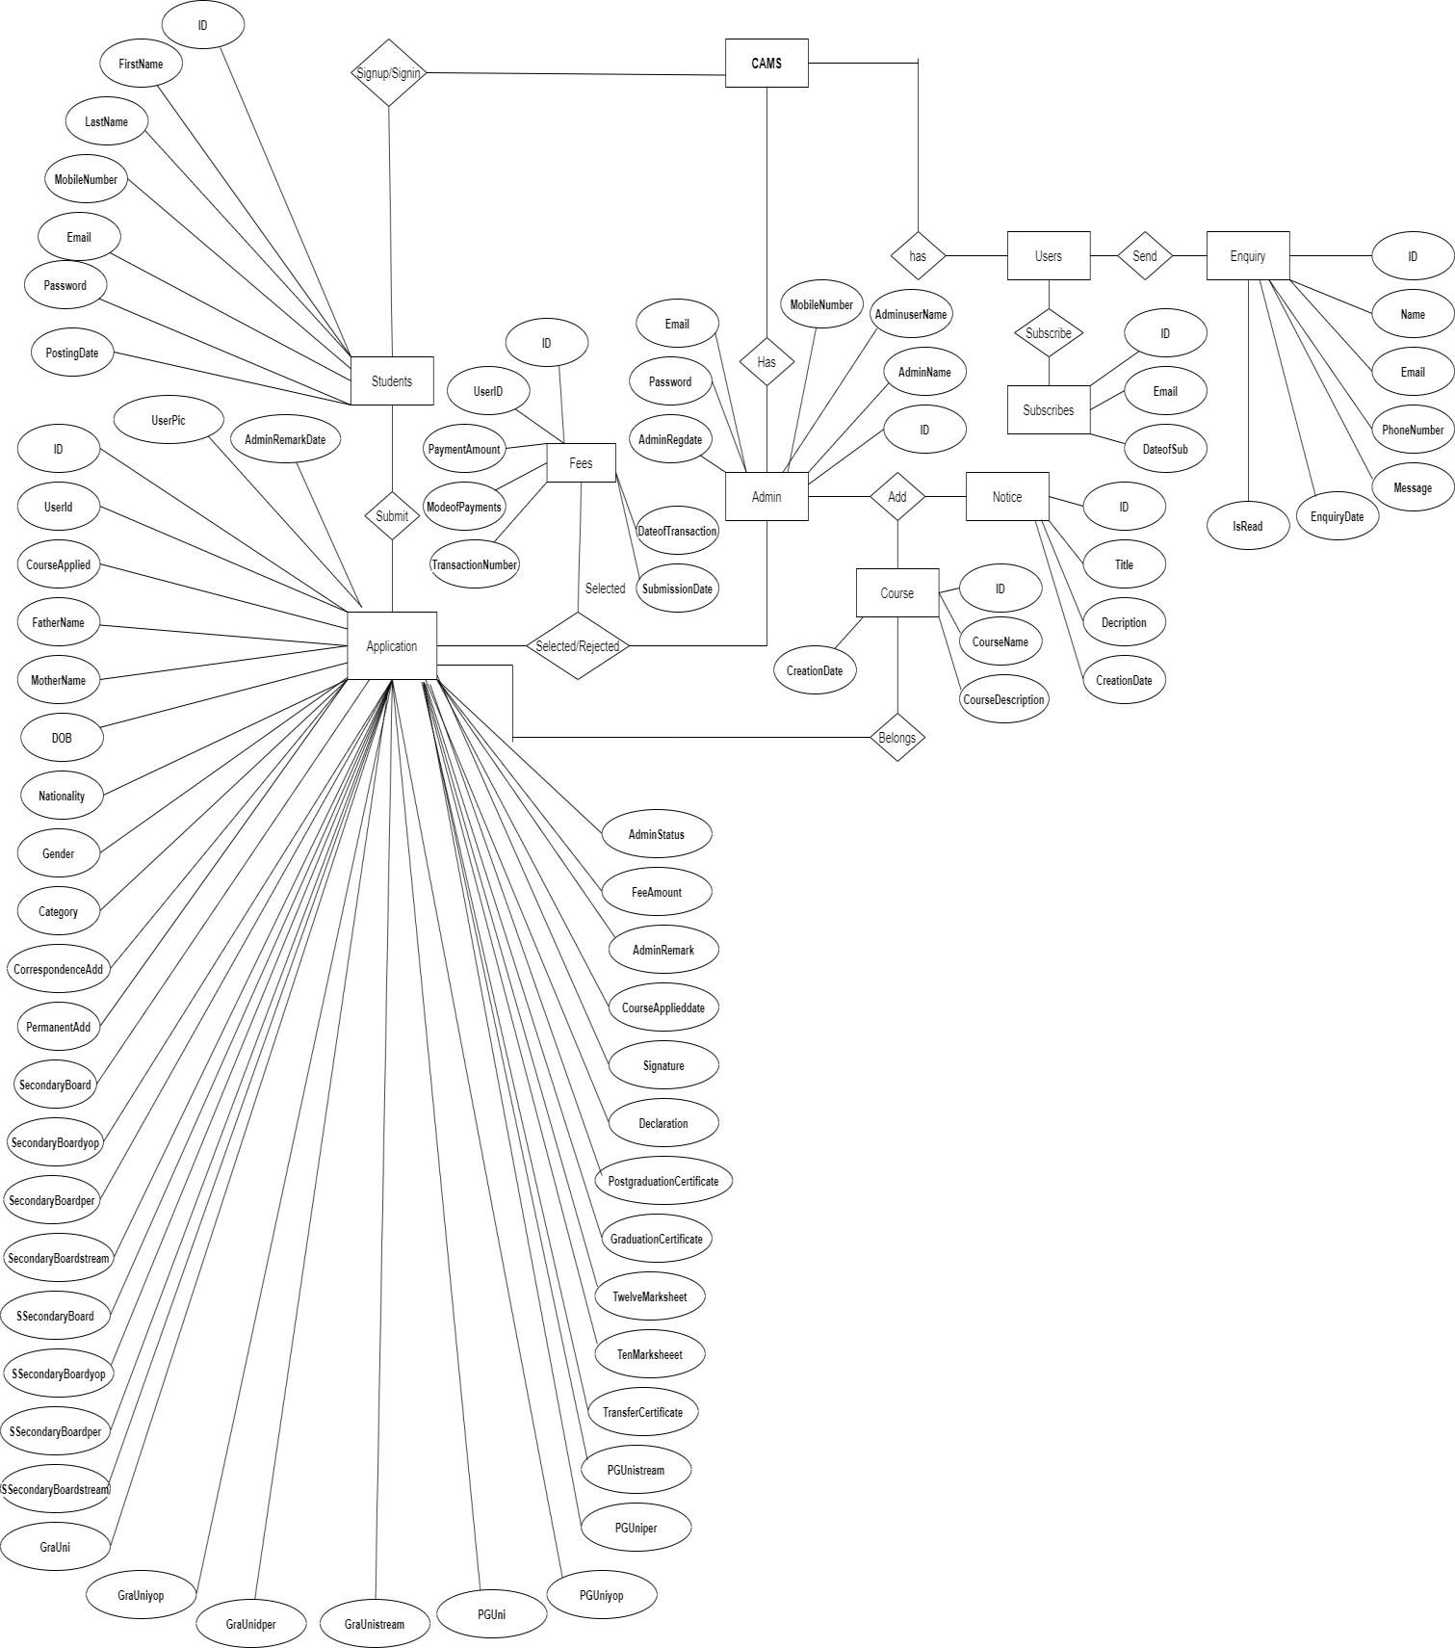
E-R DIAGRAM
E-R (Entity-Relationship) Diagram is used to represents the relationship between entities in the table.

Slide 19
Data Flow Diagram
Zero Level DFD
Notice Management
Admission Management
Pages Management
Students Management
CAMS
Subscriber Management
Enquiry Management
Course Management
1st Level DFD
Admission Management
Generate Application
Students Management
CAMS
Check Course Details
Course Management
Check Notices
Users Enquiry Management
Check Pages
Notice Management
Check Subscribers
Page Management
Search Applications

Slide 20
Manage Registered Users
2nd Level DFD
Manage Application
Admin
Login to system
Check roles of access
Manage Course
Check Credentials
Manage Notice
Forgot Password
Manage Enquiry
Manage Modules
Manage Pages
Send email to users
Manage Subscriber
Generate Report
Change Password
Change Profile
Users
Login to system
Check roles of access
Submit
Send Enquiry
Registration
Check Credentials
Subscribe
Manage Modules
Submit Fees
Forgot Password
Change Profile
Change Password

Slide 21
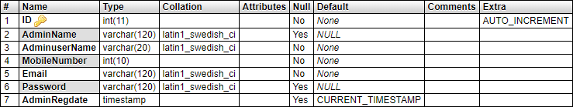
Database and MySQL Tables
MYSQL- MySQL ("My S-Q-L", officially, but also called "My Sequel") is (as of July 2013) the world's second most widely used open-source relational database management system (RDBMS). It is named after co-founder Michael Widenius daughter, My. The SQL phrase stands for Structured Query Language. The MySQL development project has made its source code available under the terms of the GNU General Public License, as well as under a variety of proprietary agreements. MySQL was owned and sponsored by a single for-profit firm, the Swedish company MySQL AB, now owned by Oracle Corporation .MySQL is a popular choice of database for use in web applications, and is a central component of the widely used LAMP opens source web application software stack (and other 'AMP' stacks). LAMP is an acronym for "Linux, Apache, MySQL, Perl/PHP/Python." Free-software-open source projects that require a full-featured database management system often use MySQL. For commercial use, several paid editions are available, and offer additional functionality. Applications which use MySQL databases Library Management System include: TYPO3, MODx, Joomla, WordPress, phpBB, MyBB, Drupal and other software. MySQL is also used in many high- profile, large-scale websites, including Wikipedia, Google (though not for searches), Facebook, Twitter, Flickr, and YouTube.
Database tables
In this project various tables used for maintain the information.
tbladmin
This table stores the login details of admin.

Slide 22
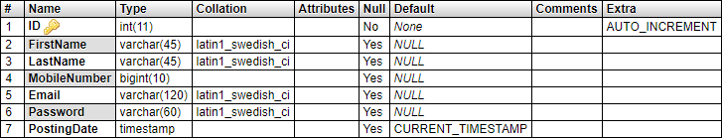
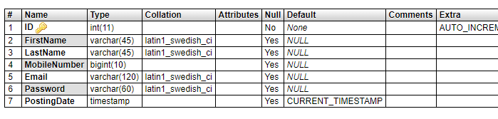
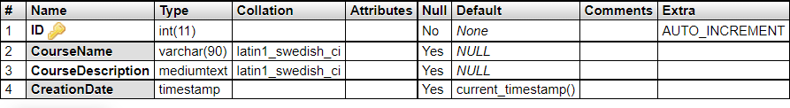

tbluser
This table stores the details of registered users.
tblcourse
This table store the details of course which is provided by college.
tblnotice
This table store the details of notice which is generated by admin

Slide 23
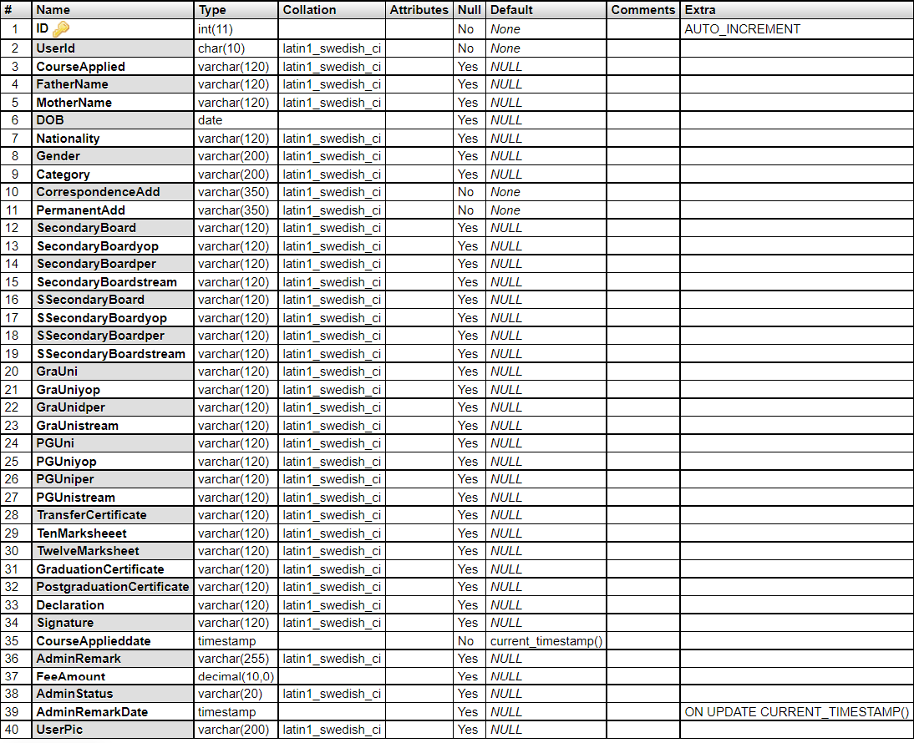
tbladmapplications
This table stores the application details which is received by students.

Slide 24
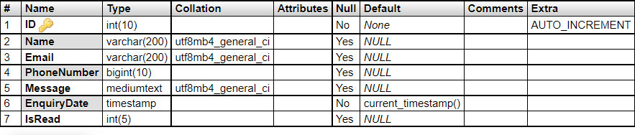
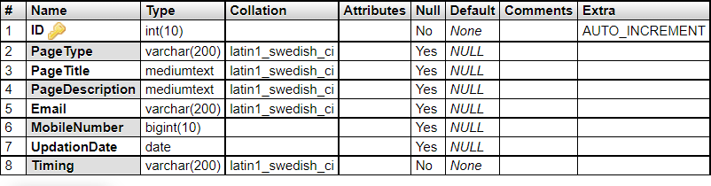

tblcontact
This table store the data of enquiry which is send by users.
tblpage
This table store the data of about us and contact us.
tblsubscriber
This table stores the emails id of subscribers.

Slide 25
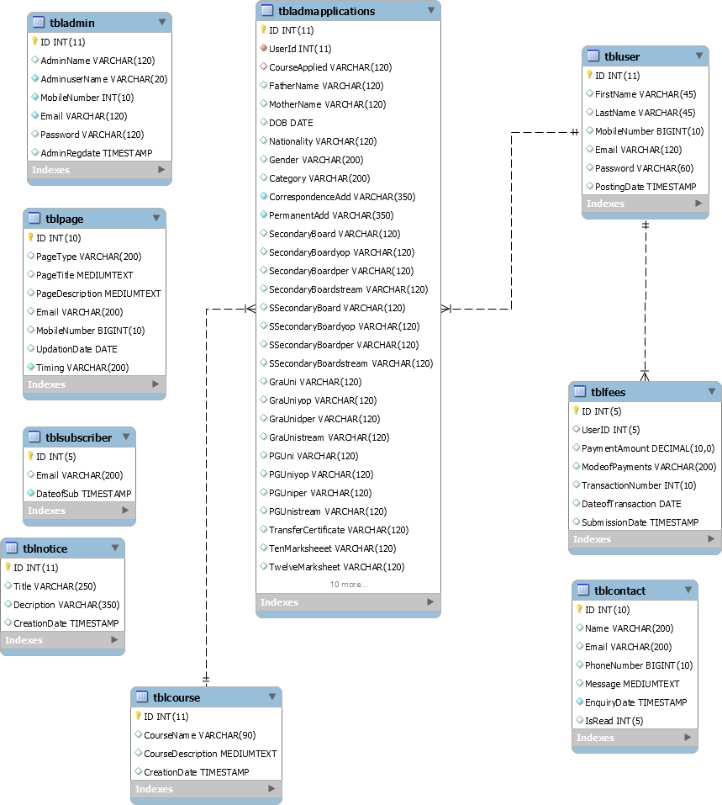
Database Tables Relation

Slide 26
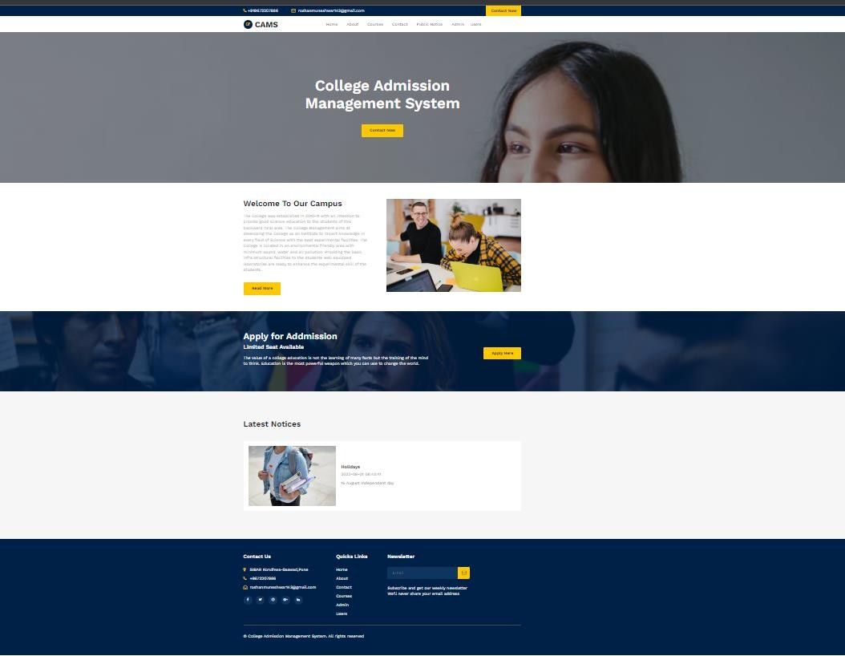
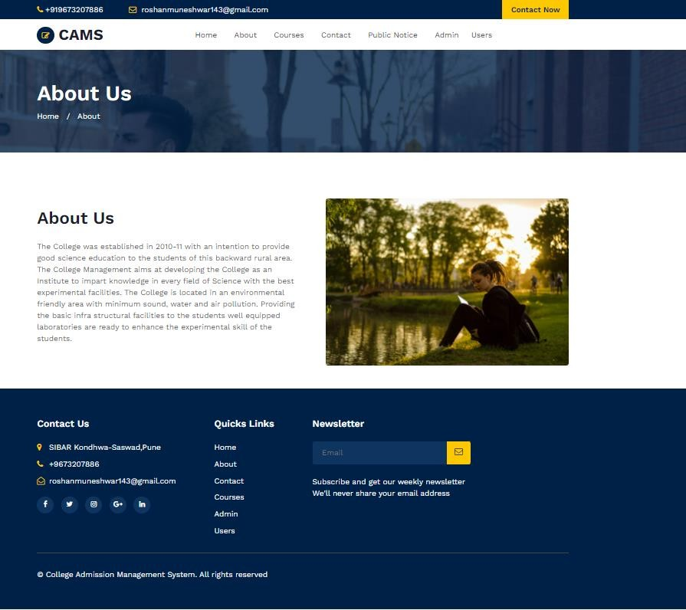
Output SCREENS
Home Page
About Us

Slide 27
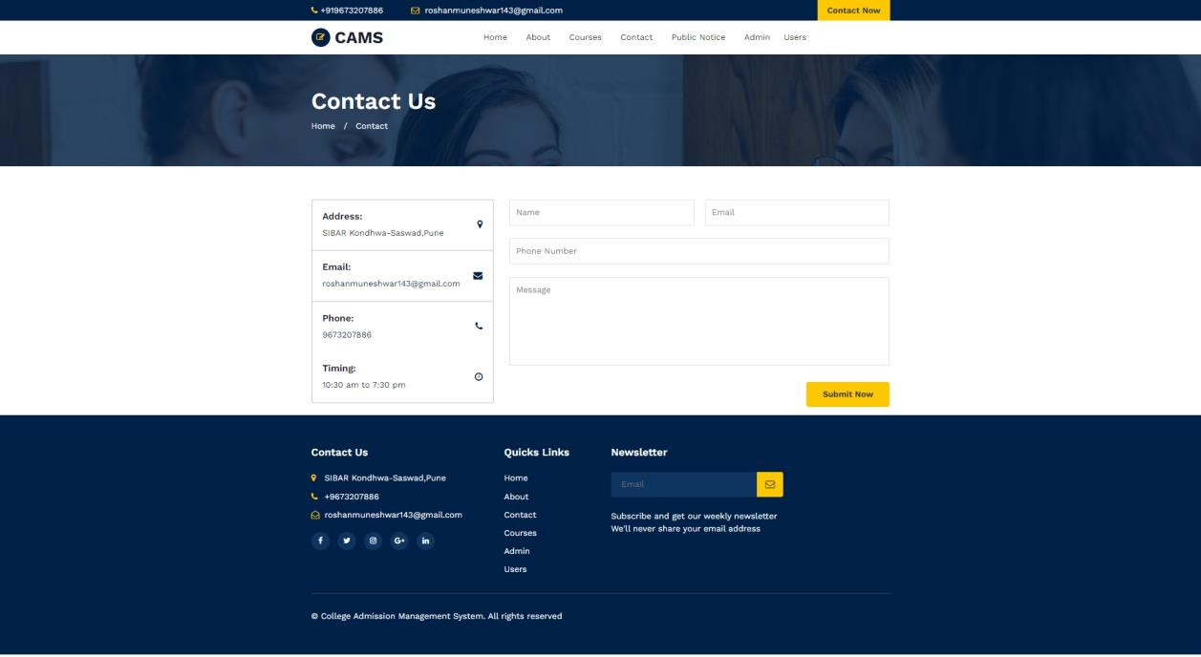
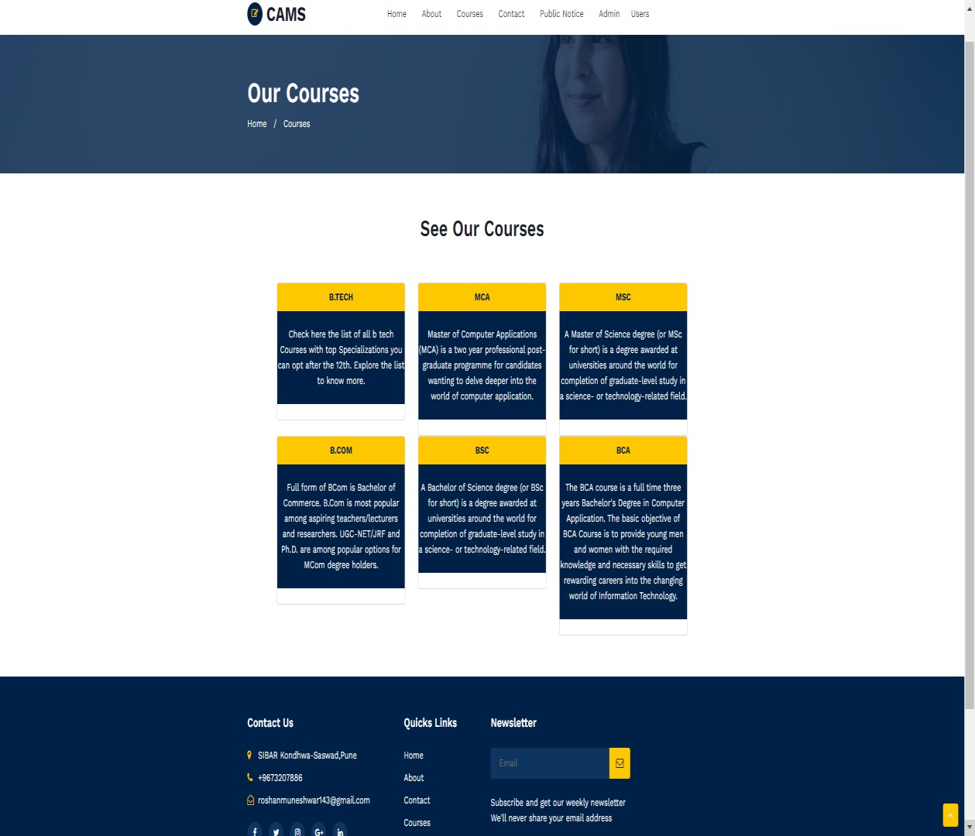
Contact Us
Courses

Slide 28
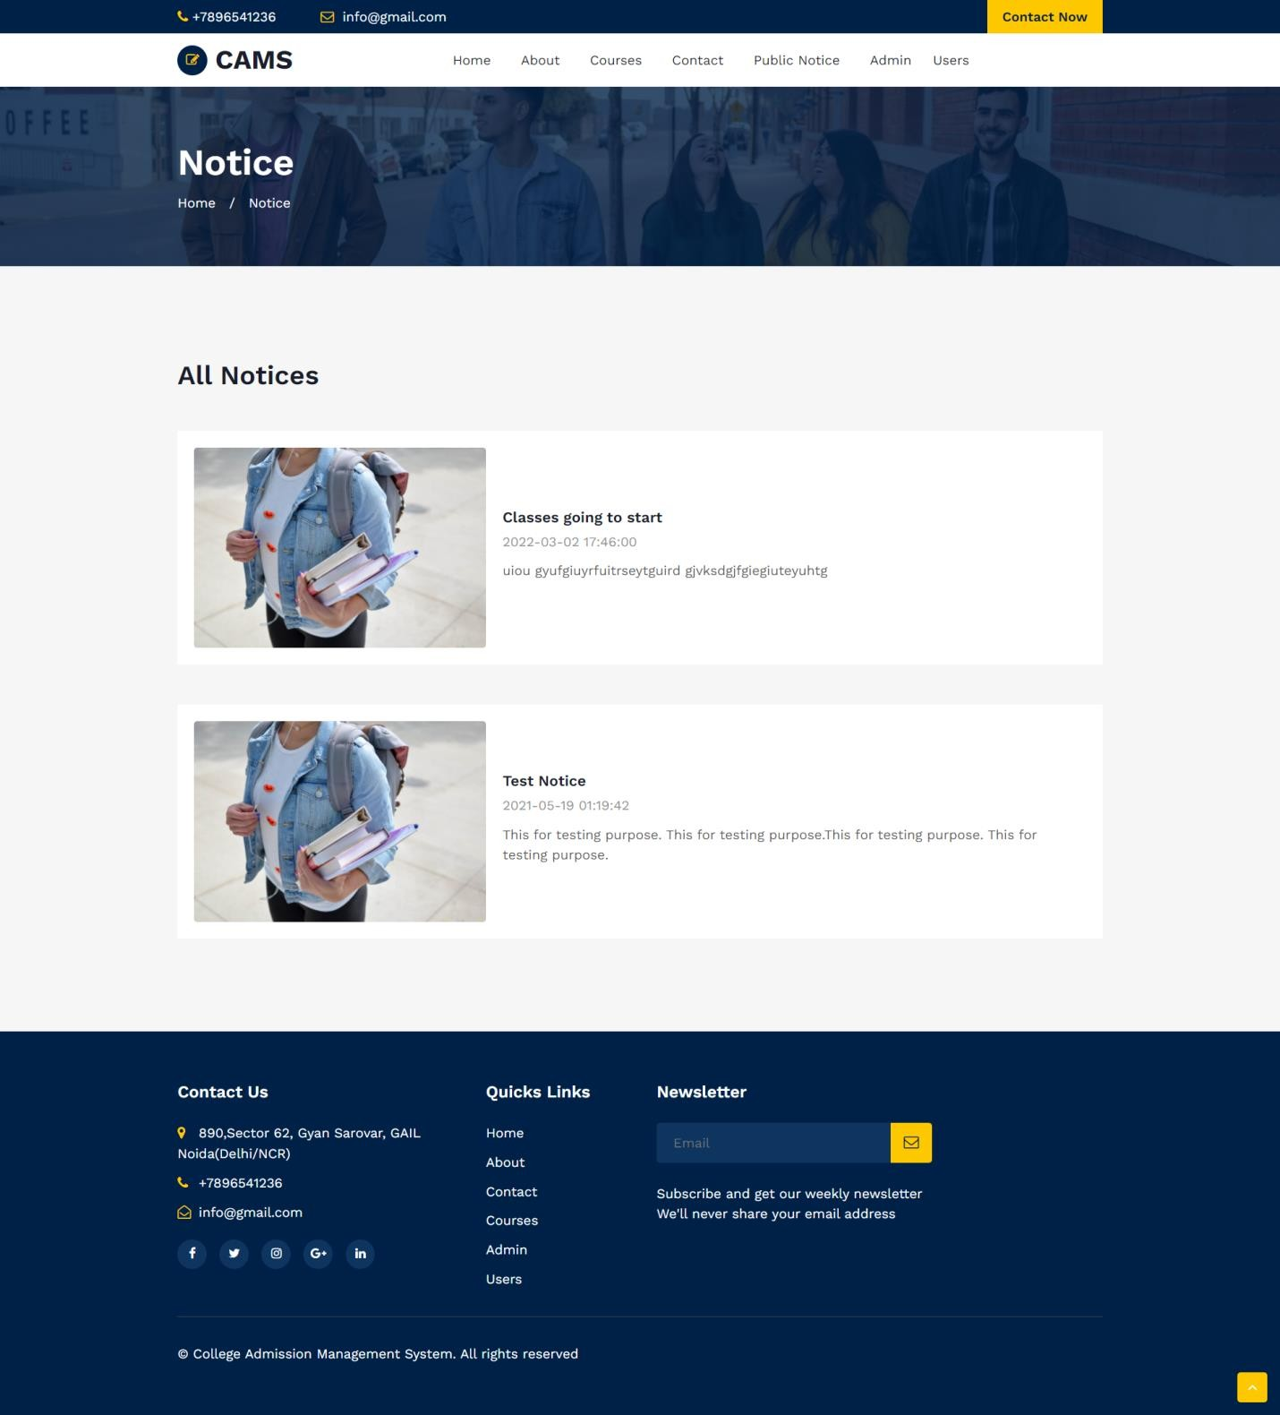
Notice

Slide 29
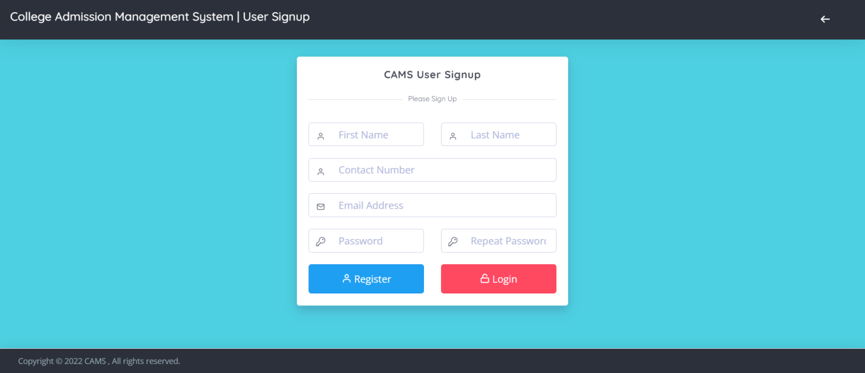
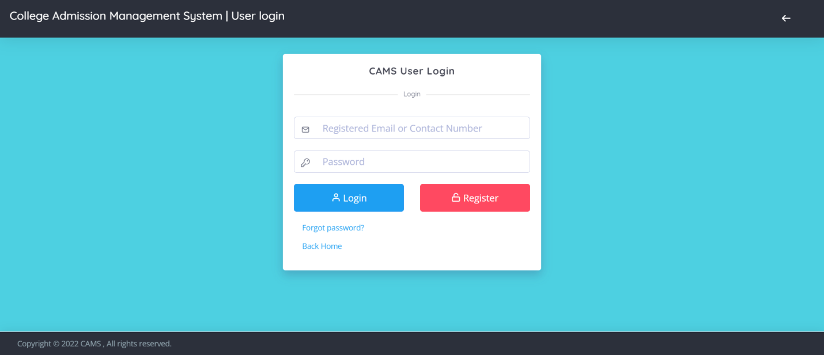
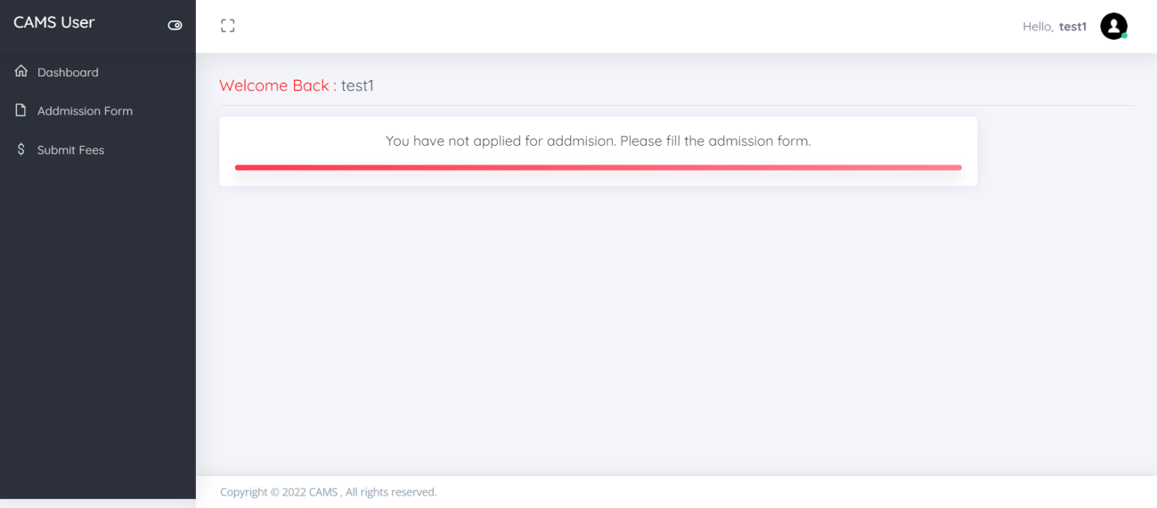
Students Panel
Signup
Login Page
Dashboard

Slide 30
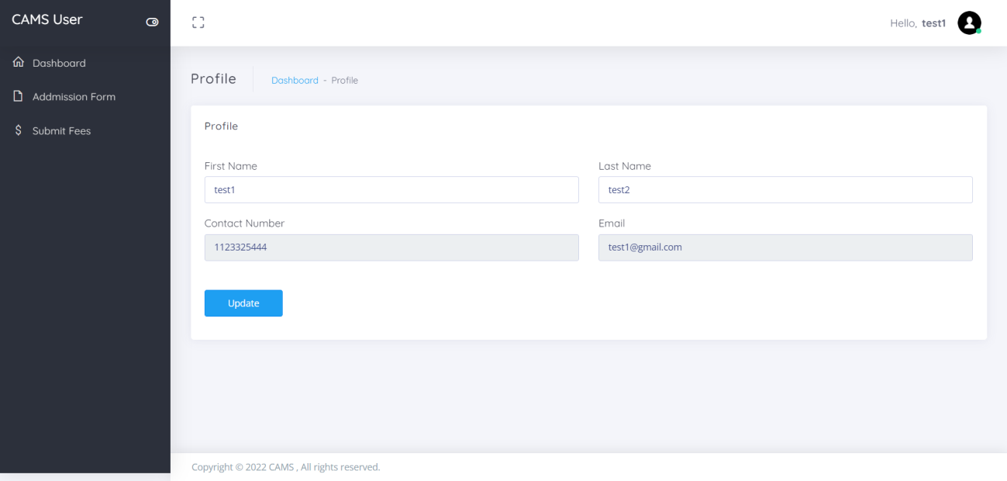
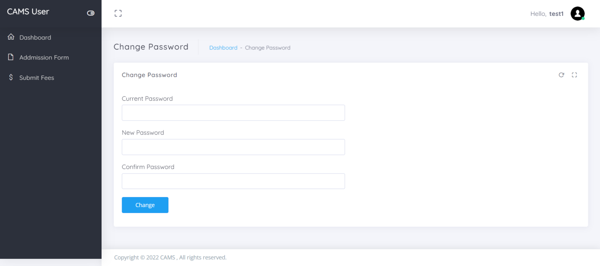
Profile
Change Password

Slide 31
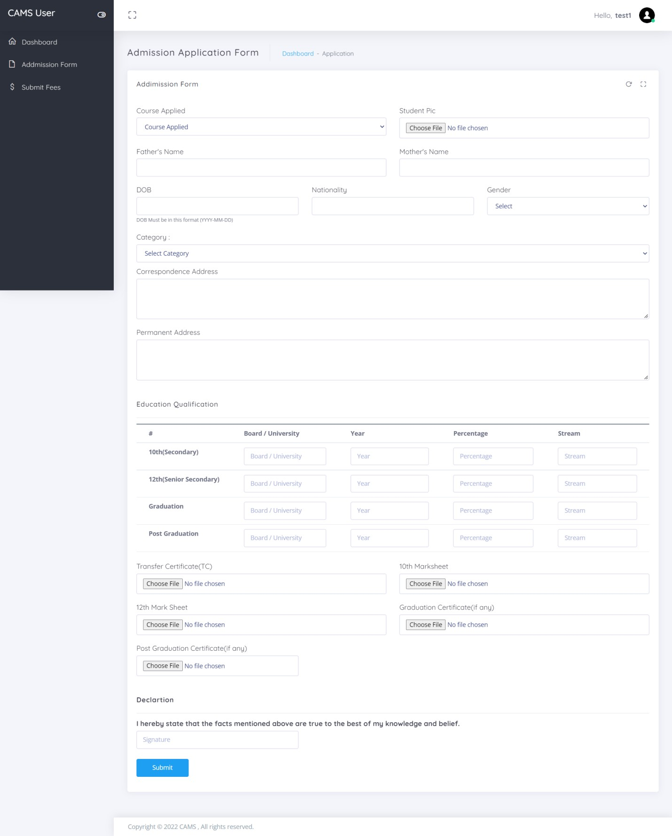
Admission Form

Slide 32
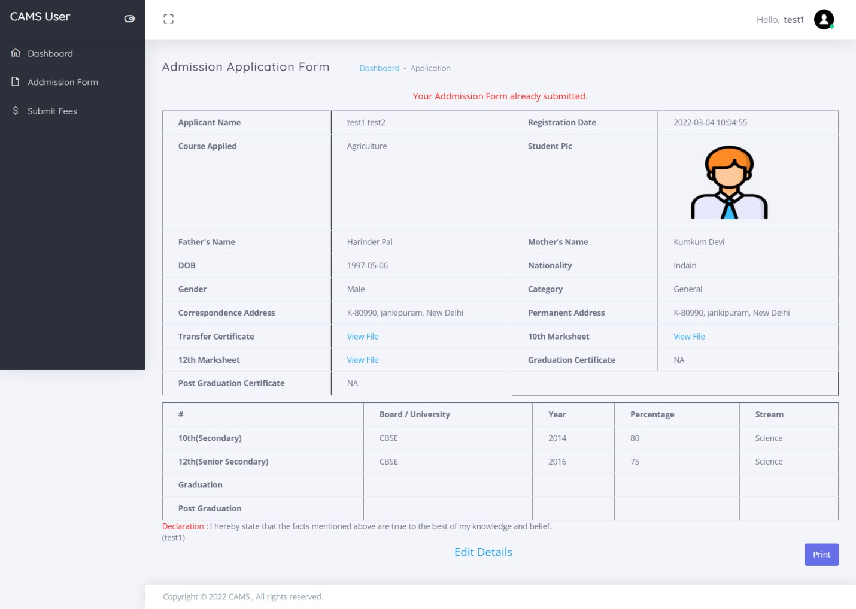
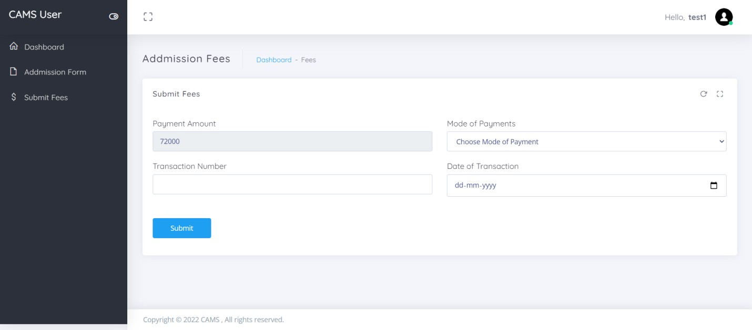
Detail of Admission Form
Submit Fees

Slide 33
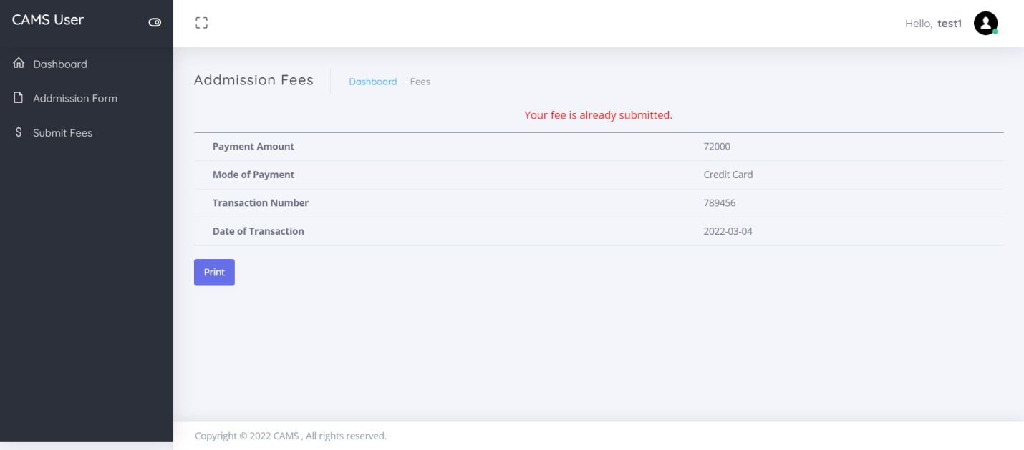
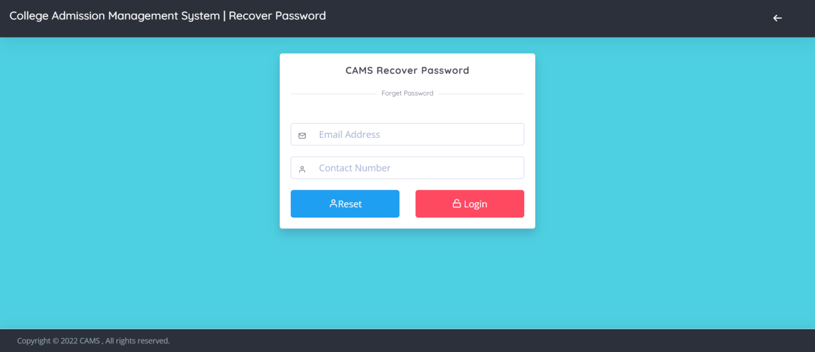
Fees submission detail
Forgot Password

Slide 34
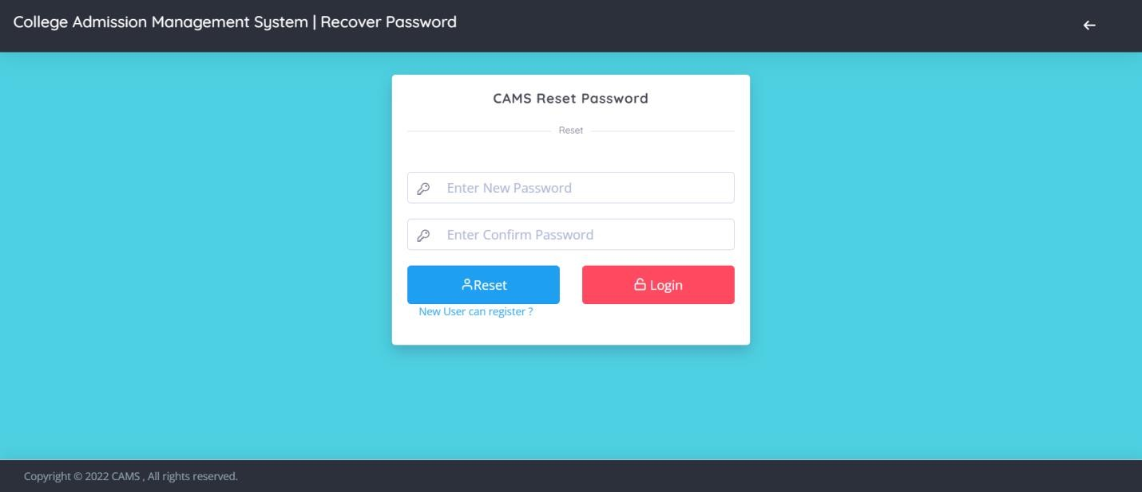
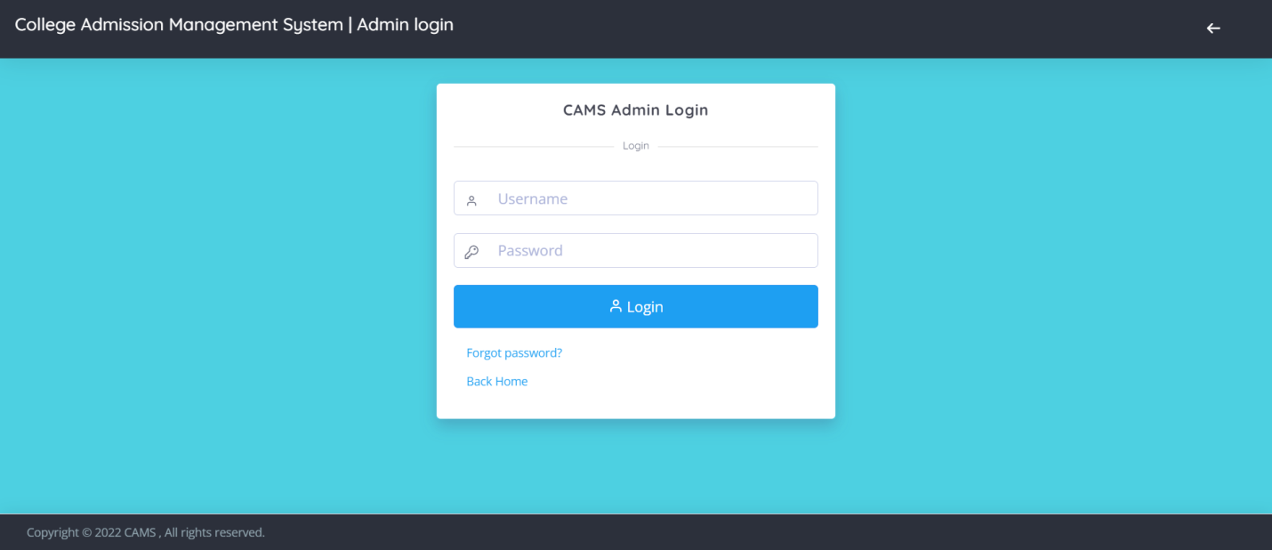
Reset Password
Admin Panel
Login Page

Slide 35
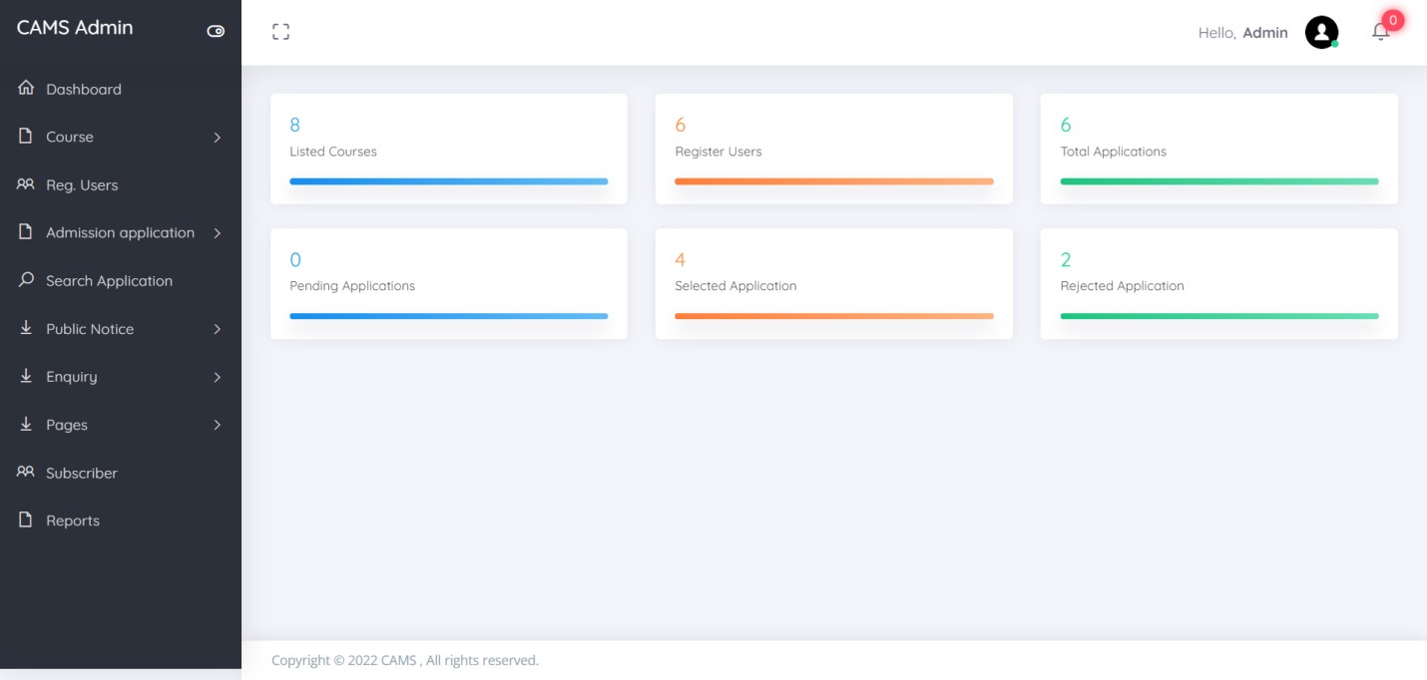
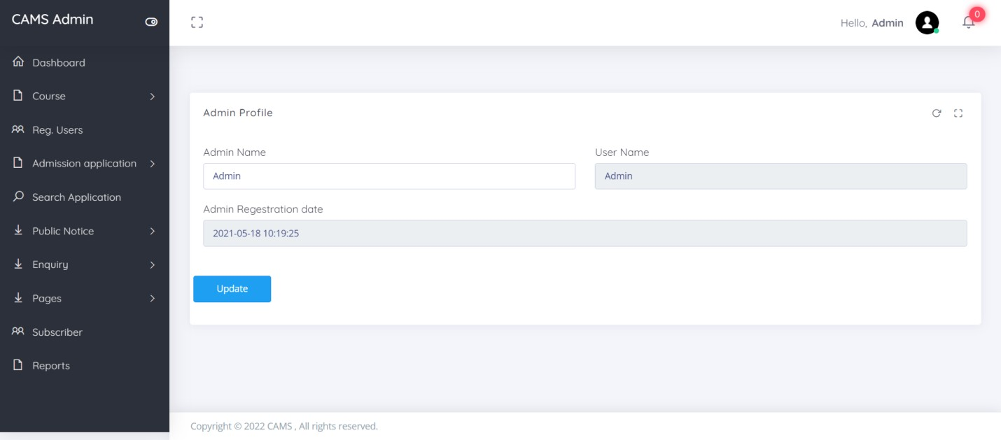
Dashboard
Profile

Slide 36
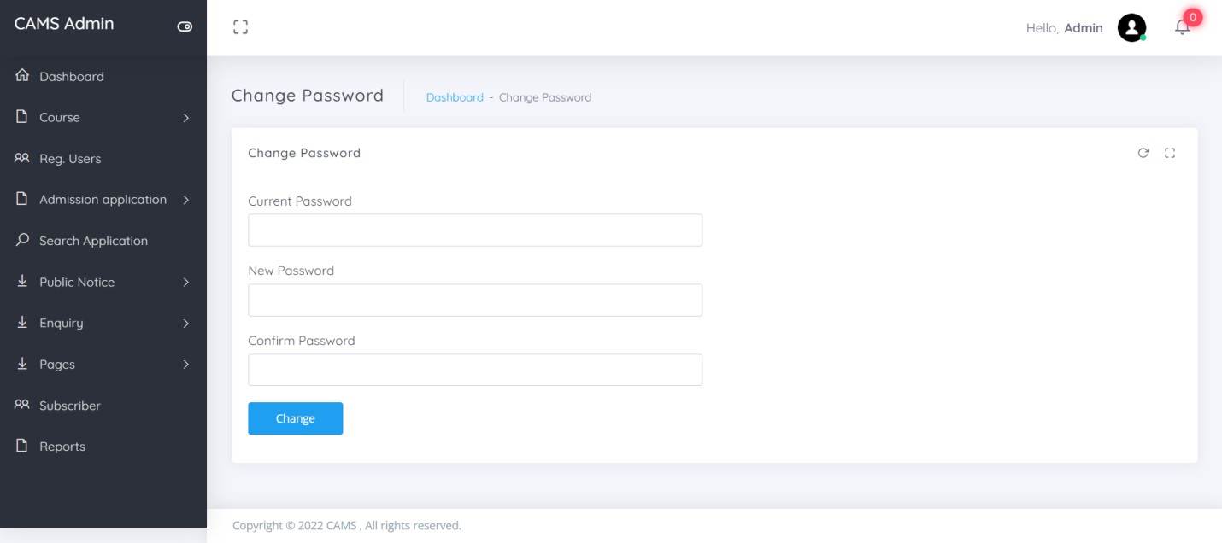
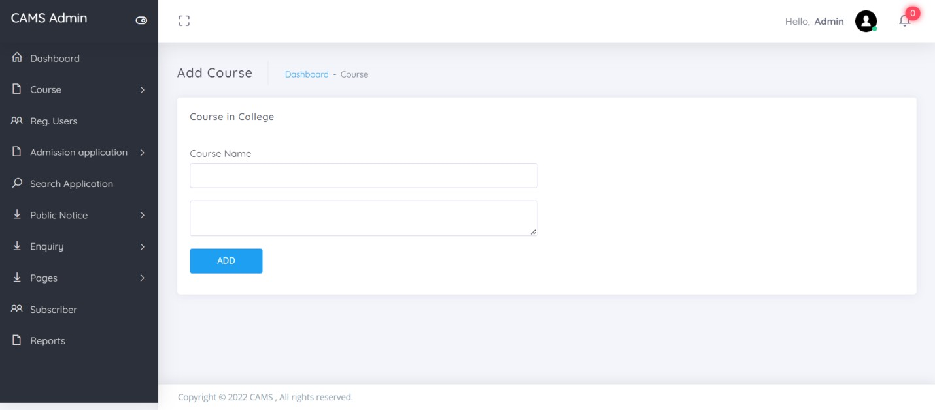
Change Password
Add Course

Slide 37
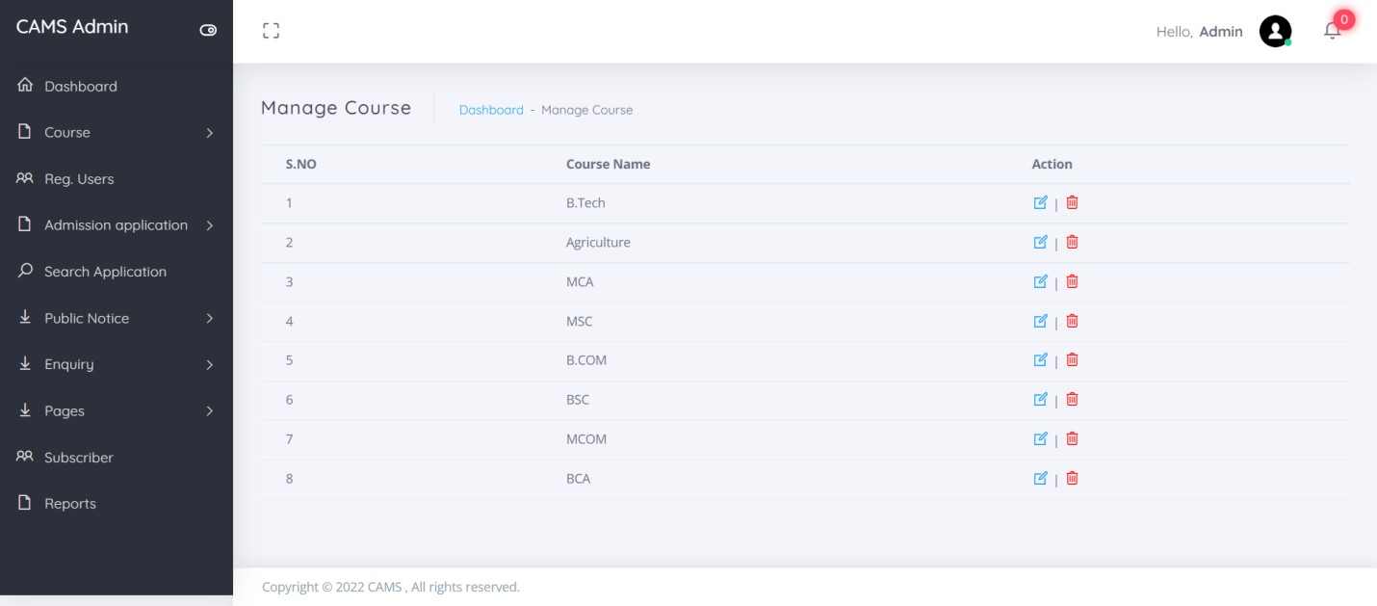
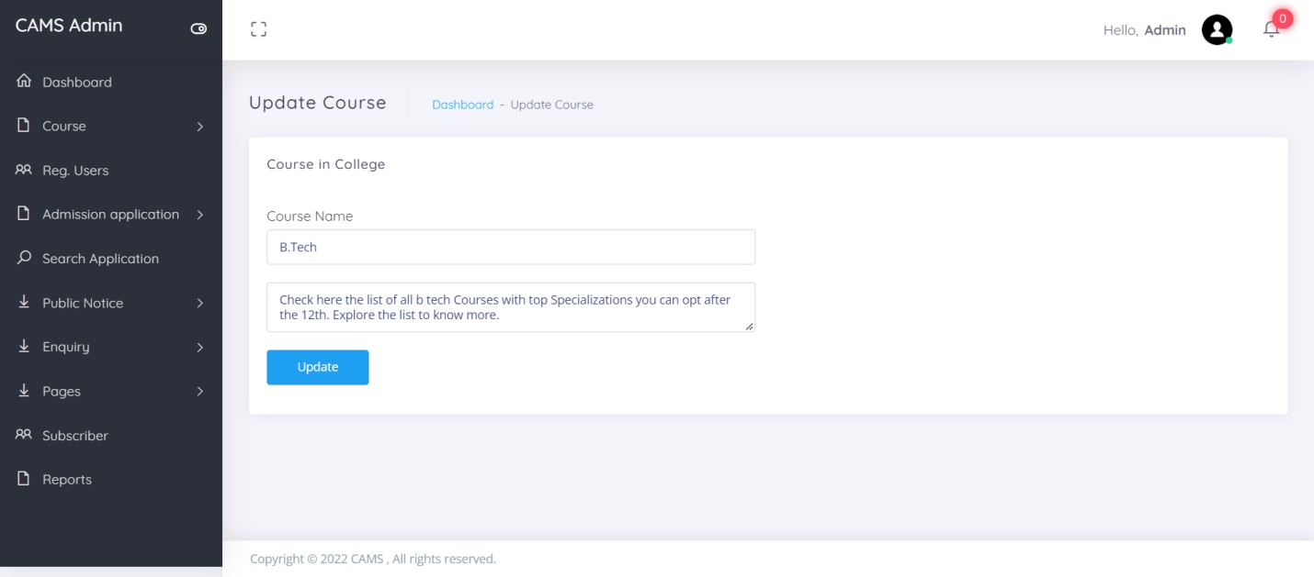
Manage Course
Update Course

Slide 38
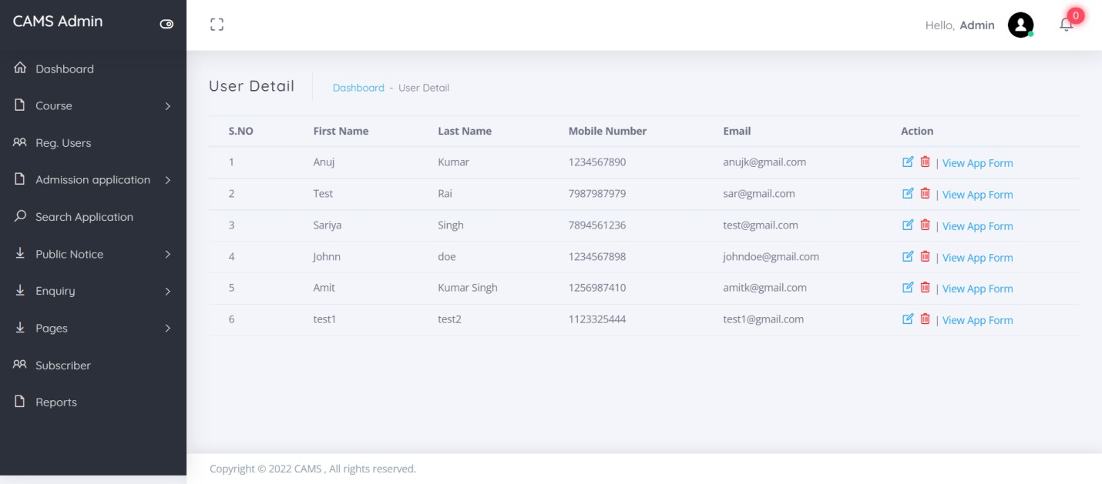
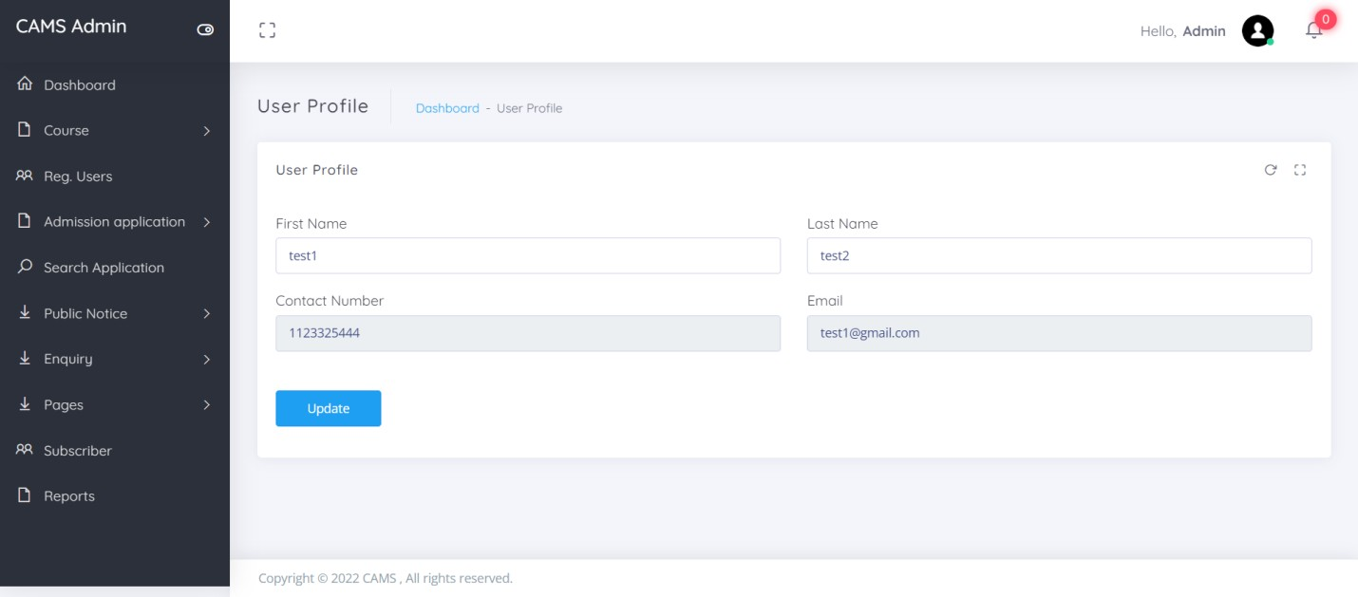
Registered Users
Update Users Details

Slide 39
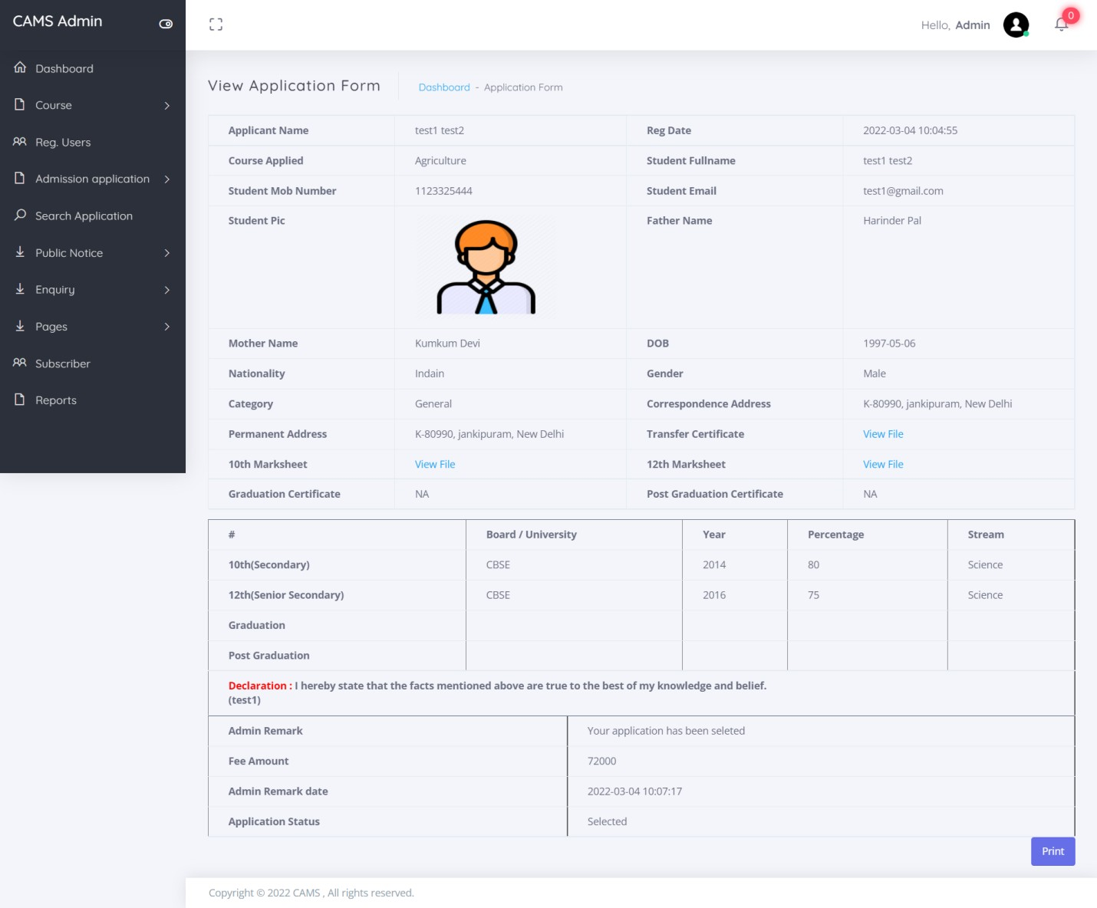
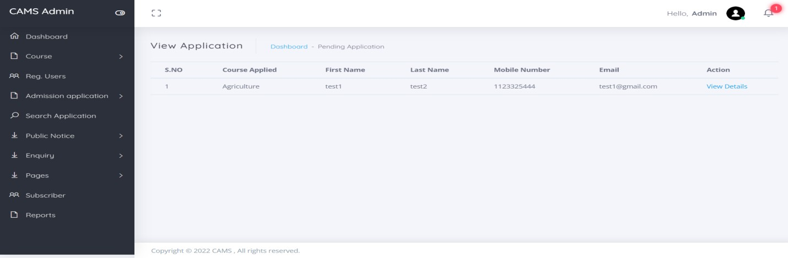
View Application Form
Pending Application

Slide 40
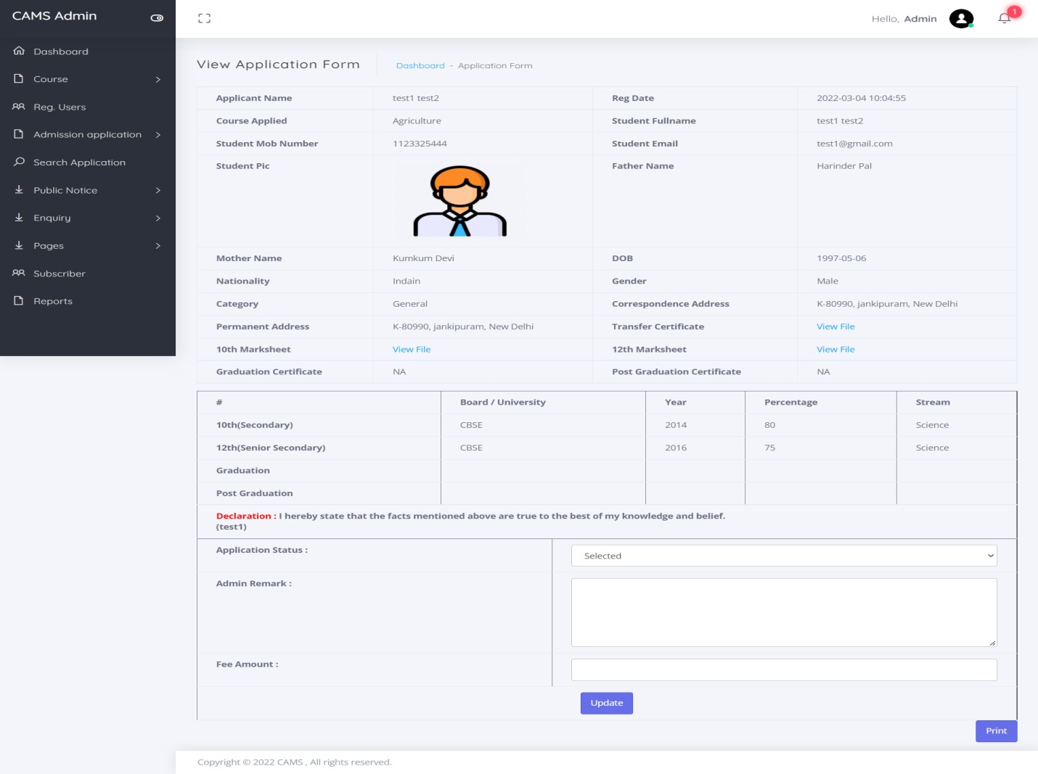
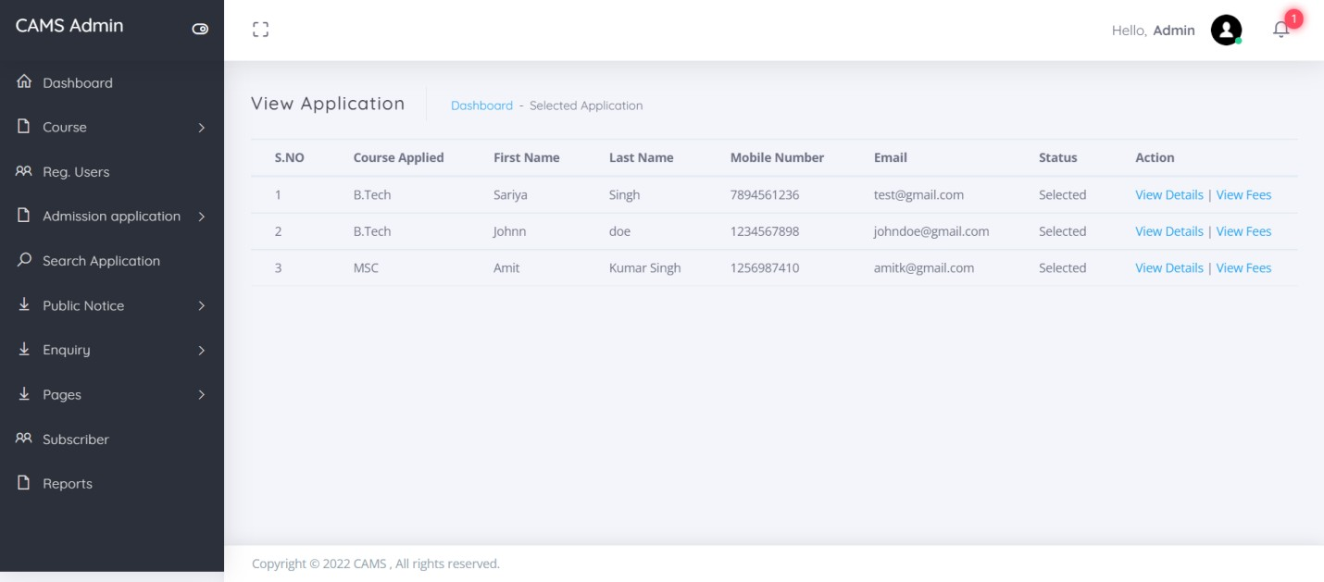
View Pending Application
Selected Application

Slide 41
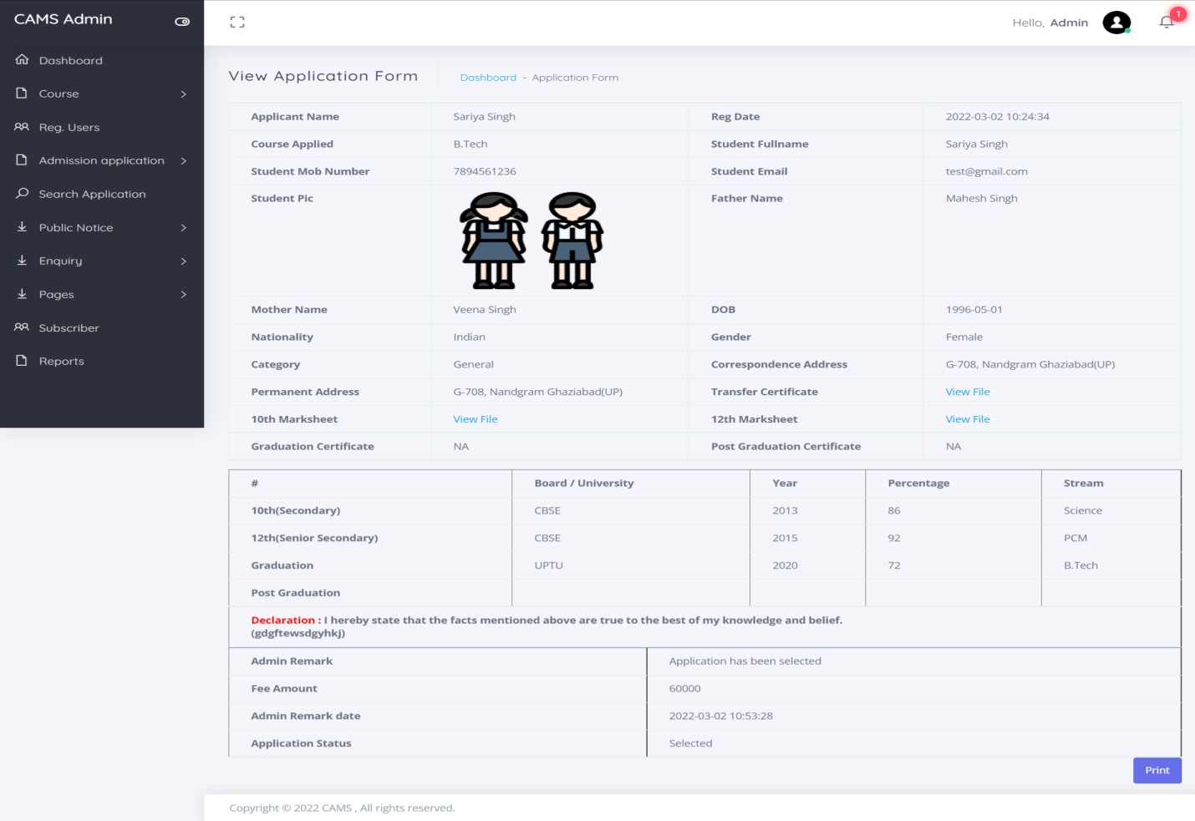
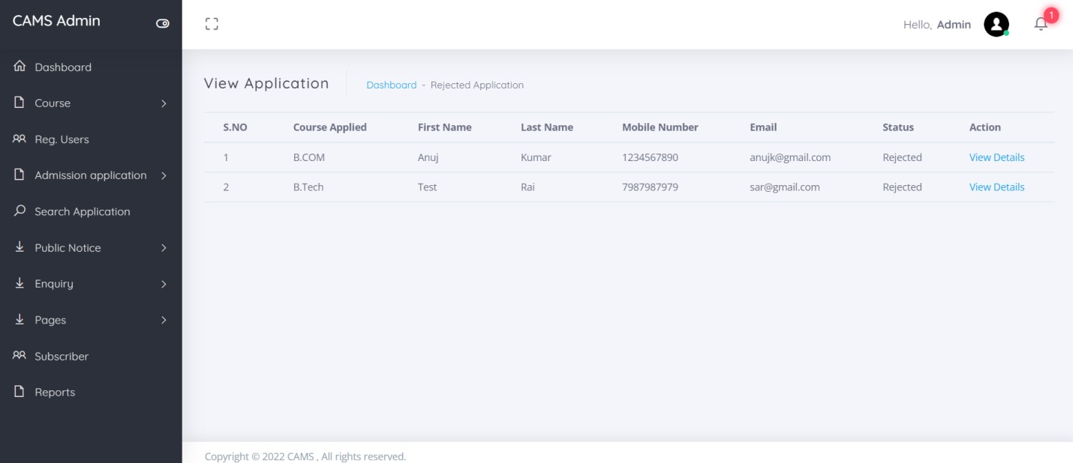
View Selected Application
Rejected Application

Slide 42
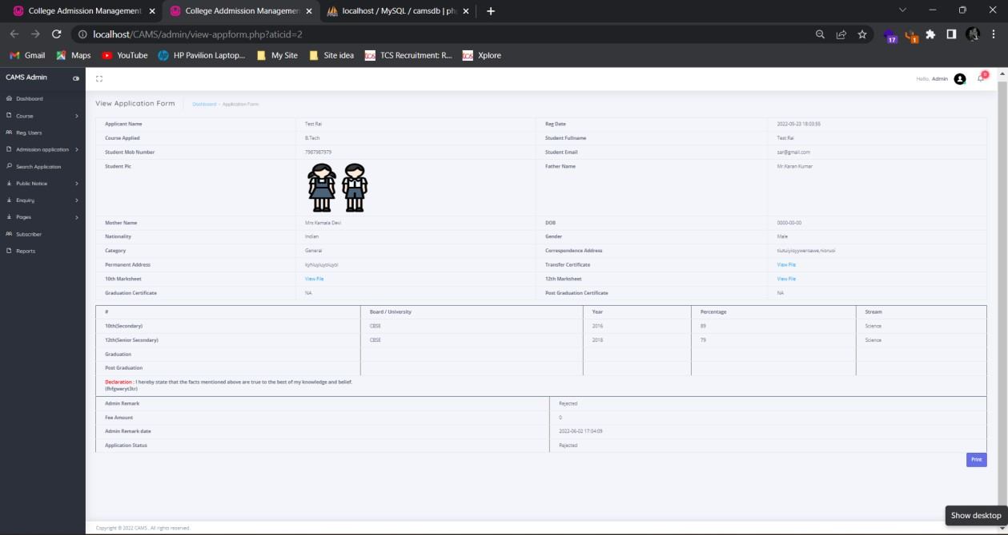
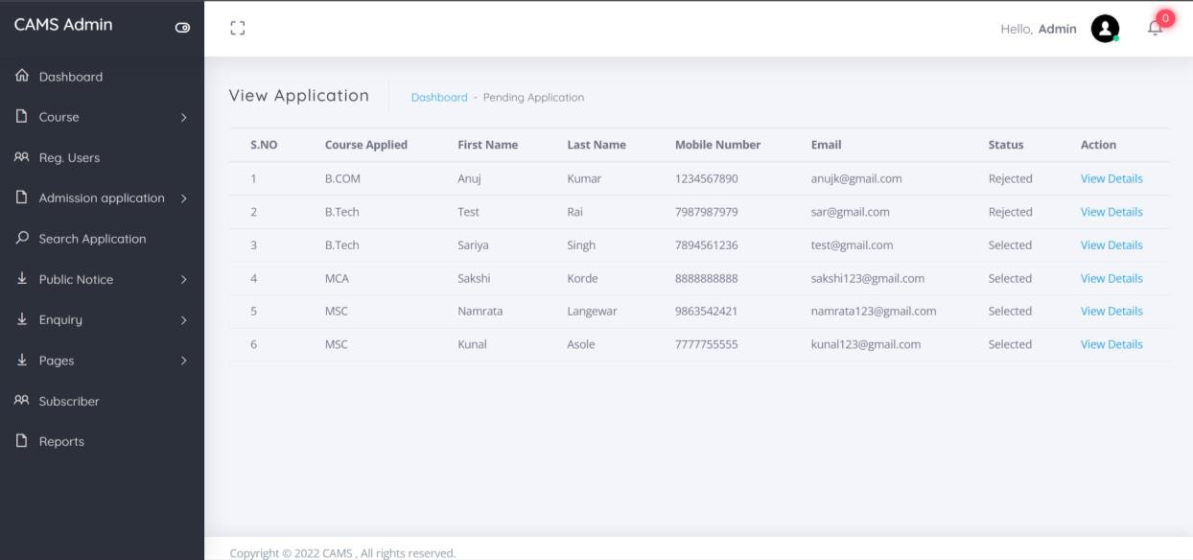
View Rejected Application
All Application

Slide 43
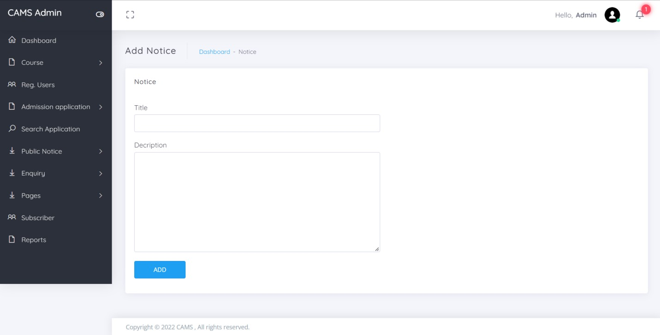
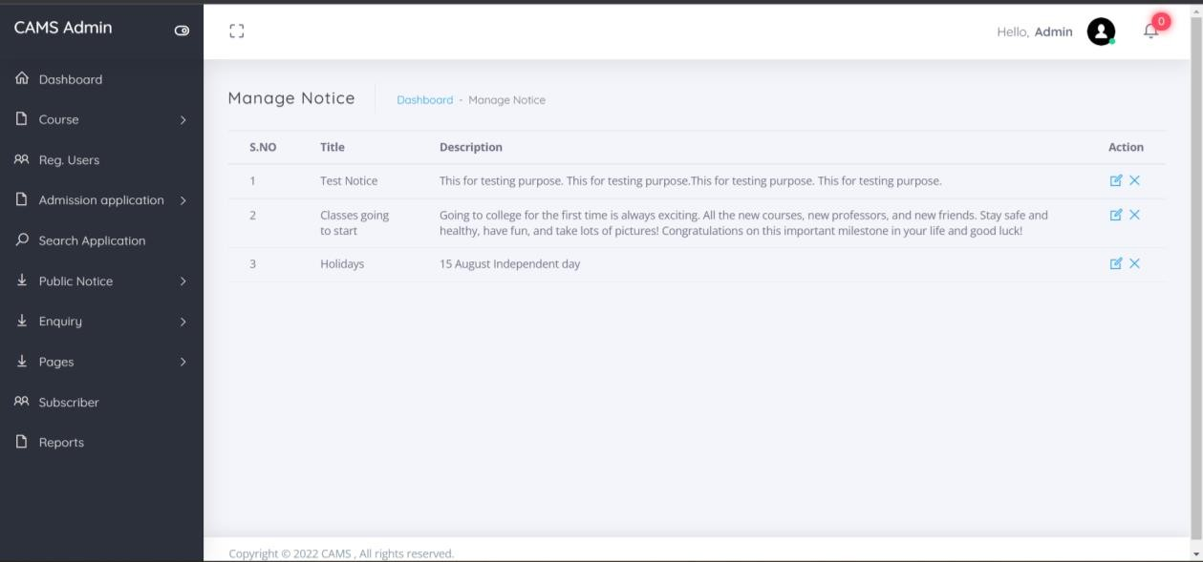
Add Notice
Manage Notice

Slide 44
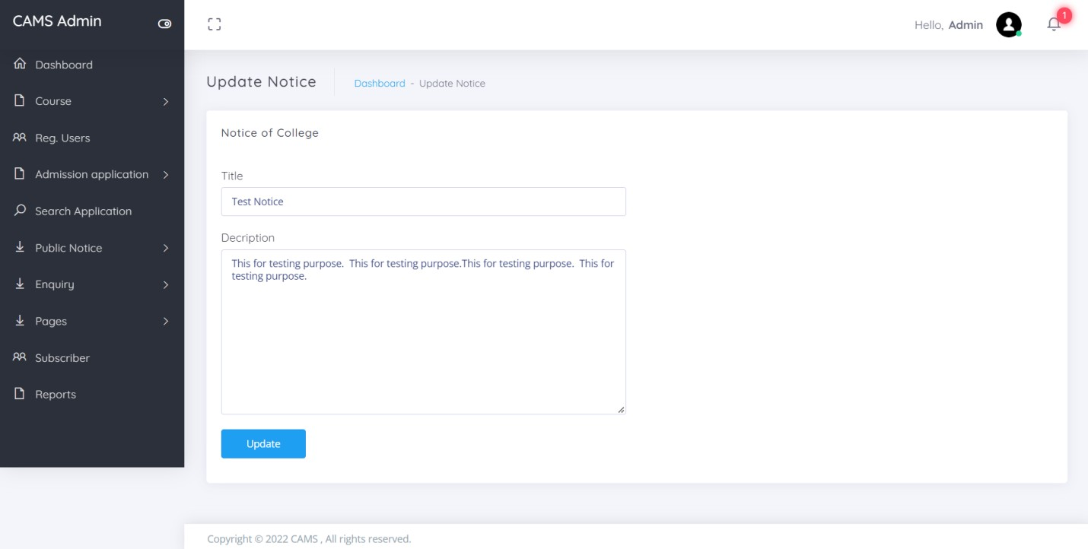
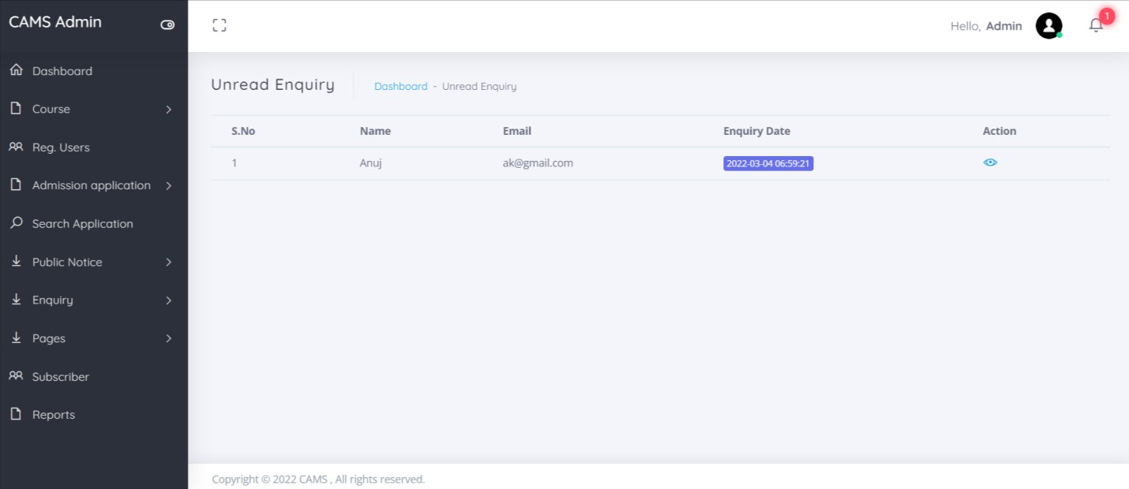
Update Notice
Unread Enquiry

Slide 45
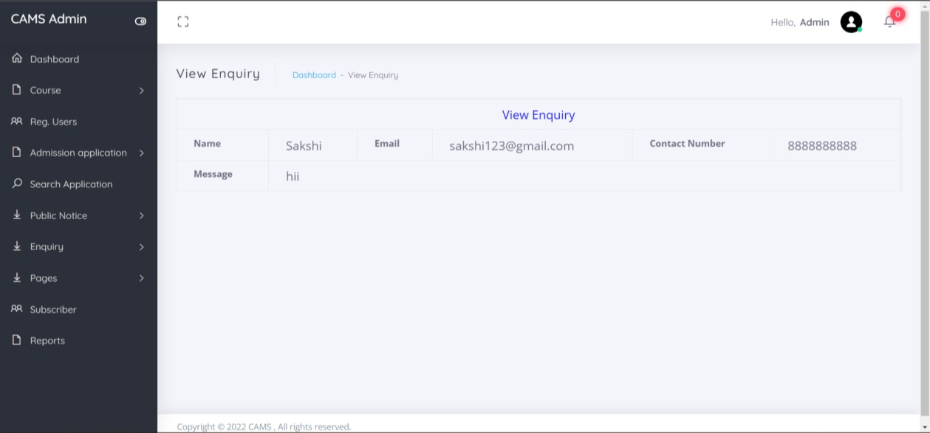
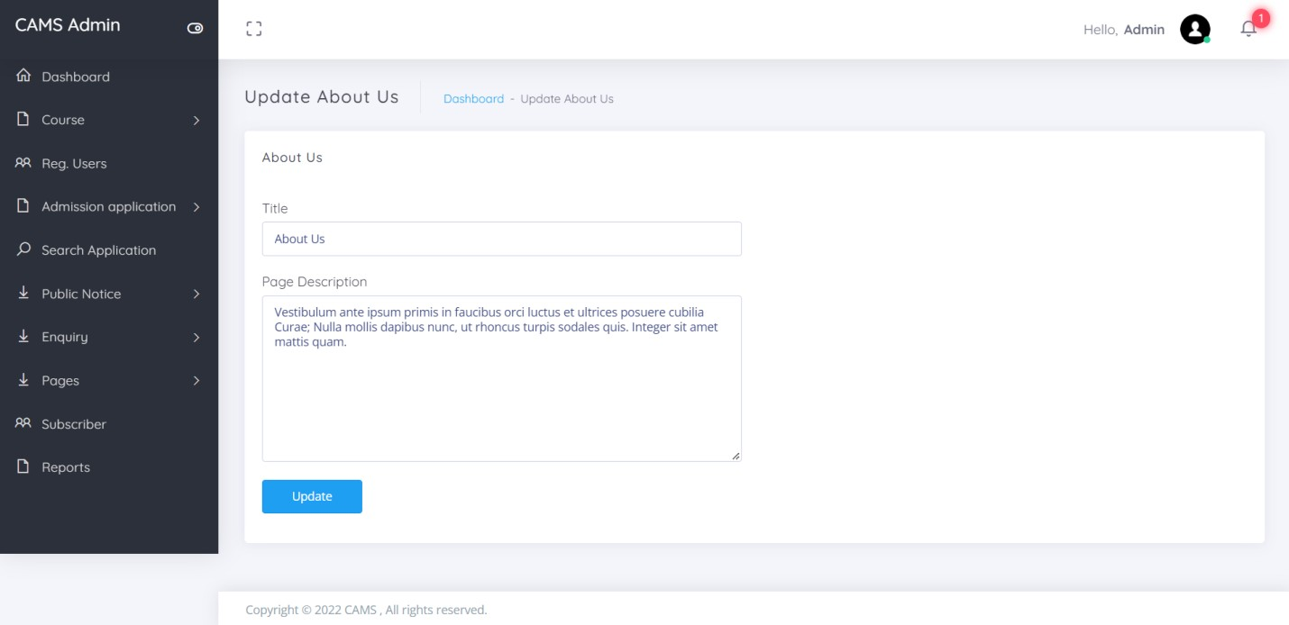
View Unread Enquiry
About Us

Slide 46
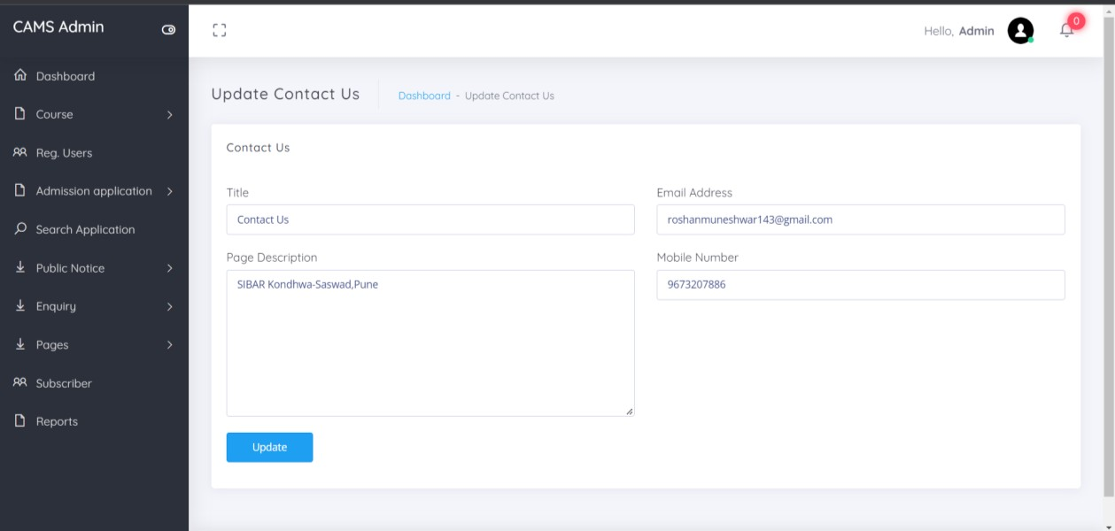
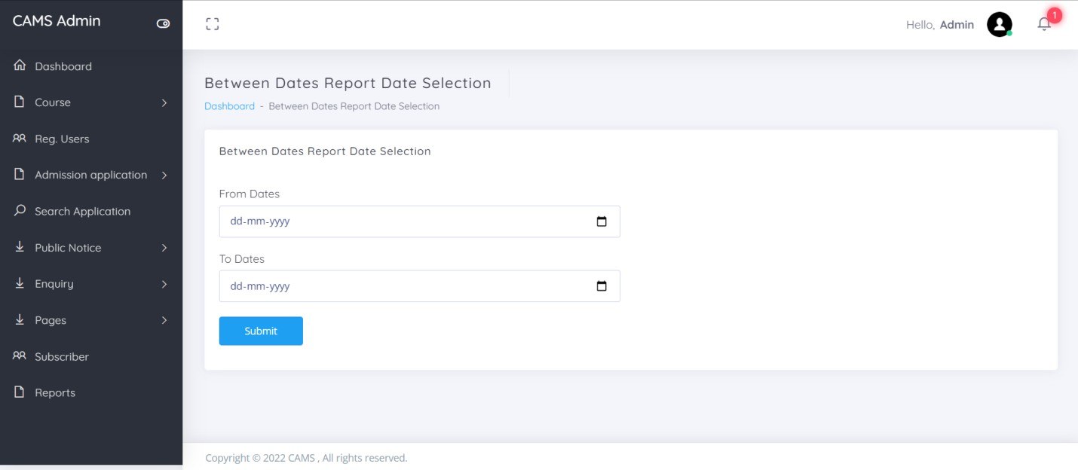
Contact Us
Between Dates Report

Slide 47



View Between Dates Reports
Forgot Password
Reset Password

Slide 48
SYSTEM TESTING
System testing is the stage of implementation, which is aimed at ensuring that
the system works accurately and efficiently before live operation commences. Testing is the process of executing the program with the intent of finding errors and missing operations and also a complete verification to determine whether the objectives are met and the user requirements are satisfied. The ultimate aim is quality assurance.
Tests are carried out and the results are compared with the expected document. In the case of erroneous results, debugging is done. Using detailed testing strategies a test plan is carried out on each module. The various tests performed in “Network Backup System” are unit testing, integration testing and user acceptance testing.
Unit Testing
The software units in a system are modules and routines that are assembled and integrated to perform a specific function. Unit testing focuses first on
modules, independently of one another, to locate errors. This enables, to detect errors in coding and logic that are contained within each module. This testing includes entering data and ascertaining if the value matches to the type and size supported by java. The various controls are tested to ensure that each performs its action as required.
Integration Testing
Data can be lost across any interface, one module can have an adverse effect on another, sub functions when combined, may not produce the desired major

Slide 49
functions. Integration testing is a systematic testing to discover errors
associated within the interface. The objective is to take unit tested modules and build a program structure. All the modules are combined and tested as a whole. Here the Server module and Client module options are integrated and tested. This testing provides the assurance that the application is well
integrated functional unit with smooth transition of data.
User Acceptance Testing
User acceptance of a system is the key factor for the success of any system. The system under consideration is tested for user acceptance by constantly keeping in touch with the system users at time of developing and making changes whenever required.

Slide 50
DESIGN AND IMPLEMENTATION CONSTRAINTS
Some of the design and implementation constraints identified are listed below:
Student is not allowed to register with same email and contact number (Unique email and contact number will be registered).
Student not has any rights to edit any data in the admission form after submission.
Once admission application selected user can upload their docs once..
This system is not support distributed database Facility.
System is limited to HTTP/HTTPS Protocols.
Implementation is the stage in the project where the theoretical design is
turned into a working system and is giving confidence on the new system for the users that it will work efficiently and effectively. It involves careful planning, investigation of the current system and its constraints on implementation, design of methods to achieve the change over, an evaluation
of change over methods. Apart from planning major task of preparing the implementation are education and training of users. The implementation process begins with preparing a plan for the implementation of the system. According to this plan, the activities are to be carried out, discussions made regarding the equipment and resources and the additional equipment has to be acquired to implement the new system. In network backup system no additional resources are needed.

Slide 51
Implementation is the final and the most important phase. The most critical
stage in achieving a successful new system is giving the users confidence that the new system will work and be effective. The system can be implemented only after thorough testing is done and if it is found to be working according to the specification. This method also offers the greatest security since the old system can take over if the errors are found or inability to handle certain type of transactions while using the new system.
User Training
After the system is implemented successfully, training of the user is one of the most important subtasks of the developer. For this purpose user manuals are prepared and handled over to the user to operate the developed system. Thus the users are trained to operate the developed system. Both the hardware and software securities are made to run the developed systems successfully in future. In order to put new application system into use, the following activities were taken care of:
Preparation of user and system documentation
Conducting user training with demo and hands on
Test run for some period to ensure smooth switching over the system
The users are trained to use the newly developed functions. User manuals
describing the procedures for using the functions listed on menu are circulated

Slide 52
to all the users. It is confirmed that the system is implemented up to users
need and expectations.
Security and Maintenance
Maintenance involves the software industry captive, typing up system resources .It means restoring something to its original condition. Maintenance follows conversion to the extent that changes are necessary to maintain satisfactory operations relative to changes in the user’s environment. Maintenance often includes minor enhancements or corrections to problems that surface in the system’s operation. Maintenance is also done based on fixing the problems reported, changing the interface with other software or hardware enhancing the software. Any system developed should be secured and protected against possible hazards. Security measures are provided to prevent unauthorized access of the database at various levels. An uninterrupted power supply should be so that the power failure or voltage fluctuations will not erase the data in the files.
Password protection and simple procedures to prevent the unauthorized access are provided to the users .The system allows the user to enter the system only through proper user name and password.

Slide 53
SUPPLEMENTARY REQUIREMENTS
Reduce the Cost of Admission Process: The main aim of the System is to reduce the cost needed for Admission Process, so it automatically reduces the manual power needed to perform the entire task and improve the quality of the work.
Increase the Quality of the Process: The System facilitates the work of the universities and the same time it must reduce the work load of the organization with expected quality. Quality in the sense, the system try to avoid the mistakes that are usually happen during the Admission Process because names of the students sometimes missed in the selected list and call letters for the students also not send properly to the qualified students. Make the Interface Simple as Possible.
Reduced Time: To perform any task time is one of the important factors to consider. If the system not utilize properly time, than the entire aim of system is fails and the sys tem is fails to reach its goal. So time take to process all these activities should be less but the output should be effective.

Slide 54
OTHER NONFUNCTIONAL REQUIREMENTS
Performance Requirements
Some Performance requirements identified is listed below:
The database shall be able to accommodate a minimum of 1000,000 records of Students.
The software shall support use of multiple users at a time.
There are no other specific performance requirements that will affect development.
Security Requirements
Some of the factors that are identified to protect the software from accidental or malicious access, use, modification, destruction, or disclosure are described below. Specific requirements in this area could include the need to:
Utilize certain cryptographic techniques
Keep specific log or history data sets
Assign certain functions to different modules
Restrict communications between some areas of the program
Check data integrity for critical variables
Later version of the software will incorporate encryption techniques in the user/license authentication process
Portability Requirements
Some of the attributes of software that relate to the ease of porting the software to other host machines and/or operating systems. This may include:
Java is used to develop the product. So it is easiest to port the software in any environment.

Slide 55
Maintainability
The user will be able to reset all options and all stored user variables to default settings.
Reliability
Some of the attributes identified for the reliability is listed below:
All data storage for user variables will be committed to the database at the time of entry.
Data corruption is prevented by applying the possible backup procedures and techniques.
Usability requirements
Some of the usability requirements identified for this system are listed below: o A logical interface is essential to an easy to use system, speeding up
common tasks.
o Error prevention is integral to the system and is provided in a number of formats from sanity checks to limiting free-text input.

Slide 56
CONCLUSION
In this way we are going to develop college admission system, which is helpful
for Reduction in manual work so less manpower required. Students’ records can be accessed within few seconds, Clarity in account section. Our system primarily focuses on building an efficient and user friendly communication system for the educational institutions.

Slide 57
REFERENCE
PHP.net.
Sitepoint.com
W3School.com
Google web search
Wikipedia

